Slide 1
UML & Together 2006 tutorial
Hong Qing Yu 10/2006

Slide 2
Tutorial contents
UML basic
Use case diagram
Class diagram
Activity diagram
Sequence diagram
StateMachine diagram
Together 2006
Homework

Slide 3


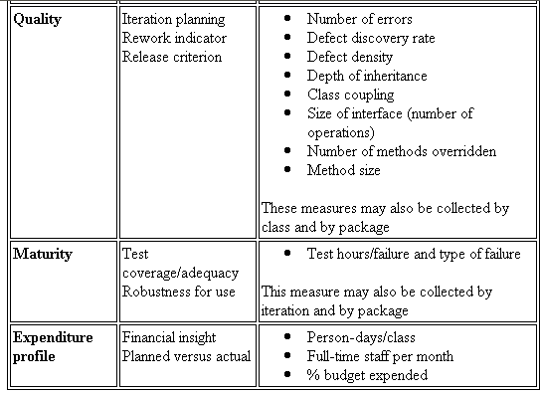


UML Diagram – What is UML?
The Unified Modeling Language (UML) is a standard language for
Specifying
Visualizing
Constructing
Documenting
Business Modeling
Communications

Slide 4
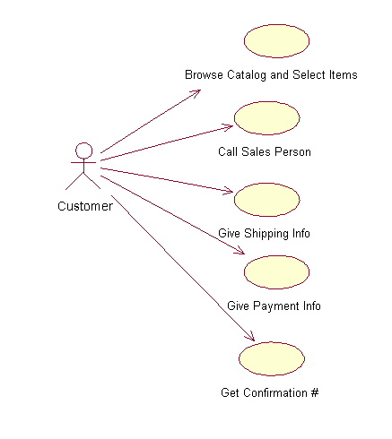
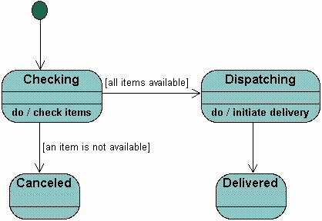
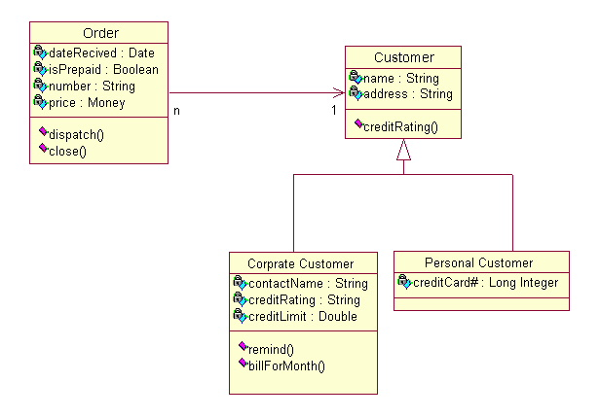
Different Views
Users
Designers
Analyzers

Slide 5
Use case diagram
System boundary
Actor
overview the usage requirements
presentations project stakeholders
"the meat" of the actual requirements
Use case:
A use case describes a sequence of actions that provide something of measurable value to an actor and is drawn as a horizontal ellipse
System boundary:
indicates the scope of your system. Anything within the box represents functionality that is in scope and anything outside the box is not
Actor:
An actor is a person, organization, or external system that plays a role in one or more interactions with your system
Use case
Online C2C shopping

Slide 6
Class Diagram
Name
Class diagrams show the classes of the system, their interrelationships (including inheritance, aggregation, and association), and the operations and attributes of the classes.
Associations
Aggregation
Generalization
Relations
Attributes
Operations

Slide 7
Relationships between Class Diagrams
Association -- a relationship between instances of the two classes. There is an association between two classes if an instance of one class must know about the other in order to perform its work. In a diagram, an association is a link connecting two classes.
Aggregation -- an association in which one class belongs to a collection. An aggregation has a diamond end pointing to the part containing the whole.
Generalization -- an inheritance link indicating one class is a superclass of the other. A generalization has a triangle pointing to the superclass.

Slide 8
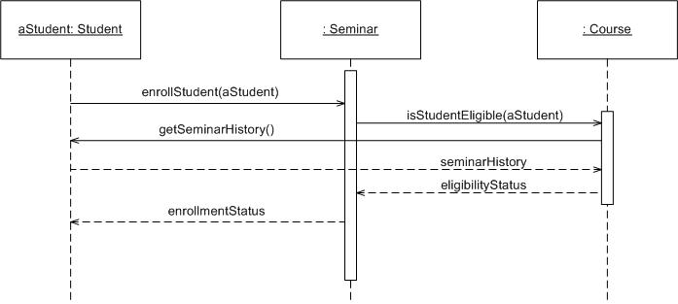
Sequence Diagram
Object: Class
A sequence diagram is
An interaction diagram that details how operations are carried out.
What messages are sent and when.
Sequence diagrams are organized according to time
Message
Operations
Lifeline

Slide 9
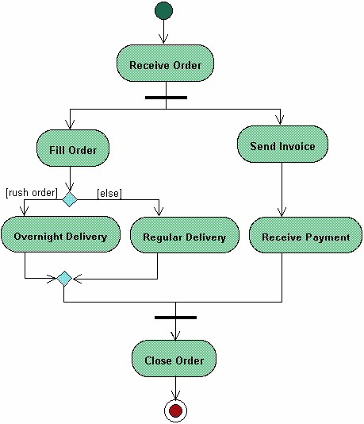
Activities Diagram
Start
Activity diagrams describe the workflow behaviour of a system
Fork
Branch
Merge
Joint
End

Slide 10
State Machine Diagram
A State Machine diagram
shows the possible states of
the object and the transitions
that cause a change in state.
?
What is different between activities and Statemachine diagram

Slide 11
Practices Section
Practice example:
Online course register System
New students can register the course, modules and tutor by themselves.
Old students can register the new modules.
There are two kinds of students, undergraduates and postgraduates.
Postgraduates students needs to check the entrance requirements.

Slide 12
Now we can start to use Together 2006
ftp://ftpc.borland.com/pub/together/techpubs/tec2006/GettingStarted.pdf
In the first 1 hour, we do the Use case diagram, class diagram and sequences
diagrams.
In the second 1 hour, we do the activities diagram and state machine diagram

Slide 13
Reading list
http://www.agilemodeling.com/essays/umlDiagrams.htm
http://www.developer.com/design/article.php/2247041
http://sparxsystems.com.au/resources/uml2_tutorial/
http://www.visual-paradigm.com/VPGallery/diagrams/index.html
http://www-128.ibm.com/developerworks/rational/library/3101.html
http://pigseye.kennesaw.edu/~dbraun/csis4650/A&D/UML_tutorial/index.htm

